Slide 1
Level 4/5 Group 6
Daniel Jamieson
Lewis Wilden
Daniel Beales
Anastazia Hunt

Slide 2
Genre / Style
2D Platformer
Pc
Competitive 2 players
Simultaneous play

Slide 3
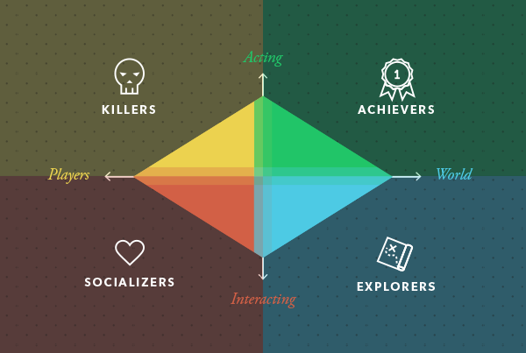
Target demographic
Socializers
Achievers
Age:
10-20
Gender:
Males and Females

Slide 4
The Game

Slide 5
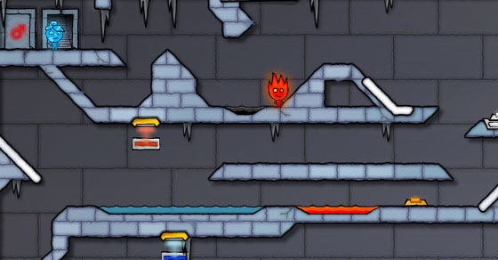
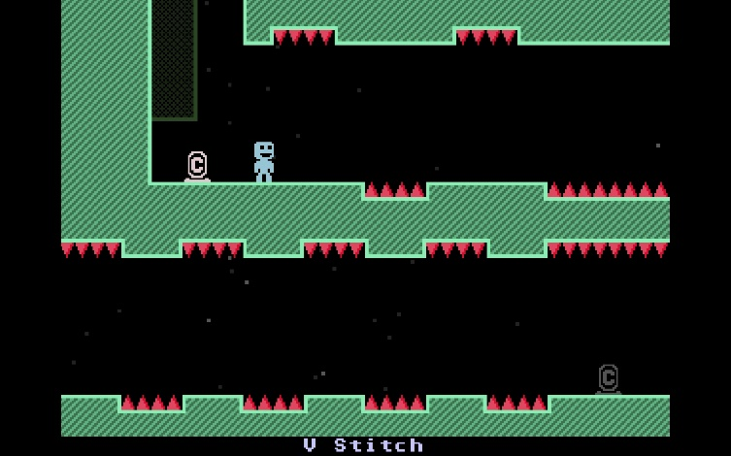
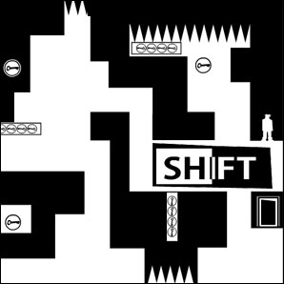
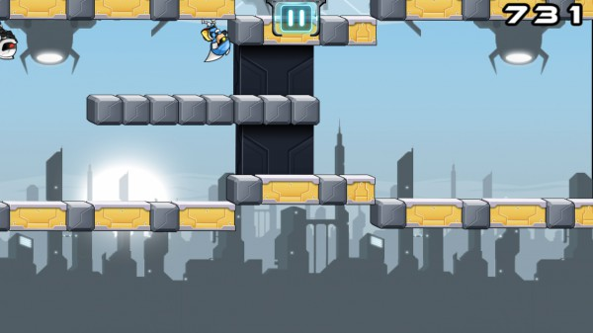
Inspired Examples

Slide 6
Mechanics
Physics
Puzzles
Simultaneous play
Timer
Pressure Plates

Slide 7
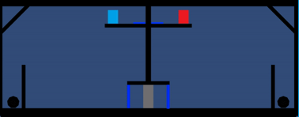
What does the player do ?
Solve puzzles
Competitive – goal
Change Gravity

Slide 8







Art style

Slide 9
Reference
http://venturebeat.com/2014/04/29/gaming-advocacy-group-the-average-gamer-is-31-and-most-play-on-a-console/
http://www.bigfishgames.com/blog/2015-global-video-game-stats-whos-playing-what-and-why/
http://www.marketingcharts.com/online/nearly-all-us-teens-53-of-adults-play-video-games-7114/

Slide 10
Questions
MOOD BOARD
ART

